Slide 1

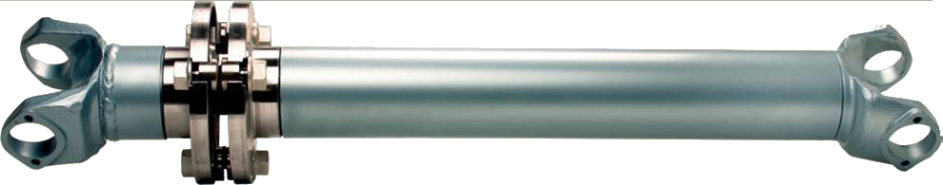
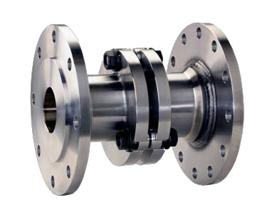
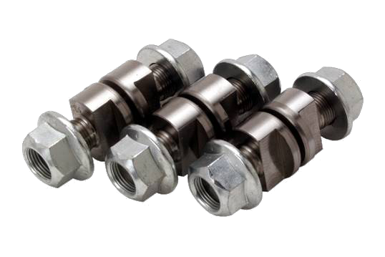
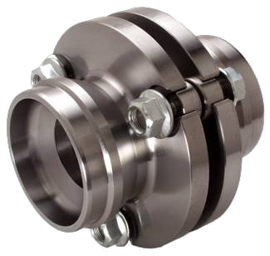
Product
Training

Slide 2
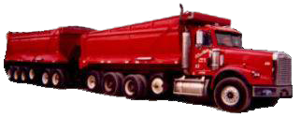
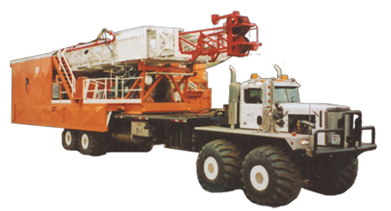
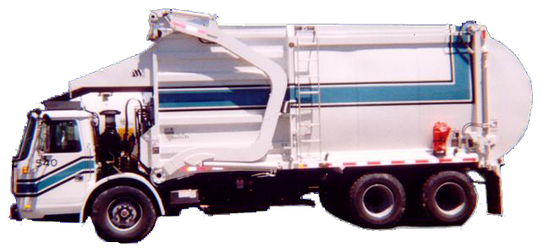
The Power Train Saver protects all types and sizes of trucks & equipment from over-torque damage.

Slide 3
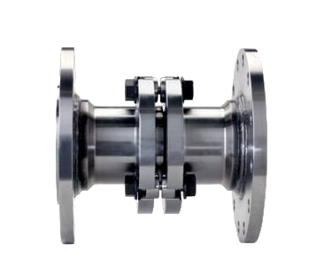
Product Types
Weld in Unit
Marine Flange Unit
Industrial Flange Unit

Slide 4
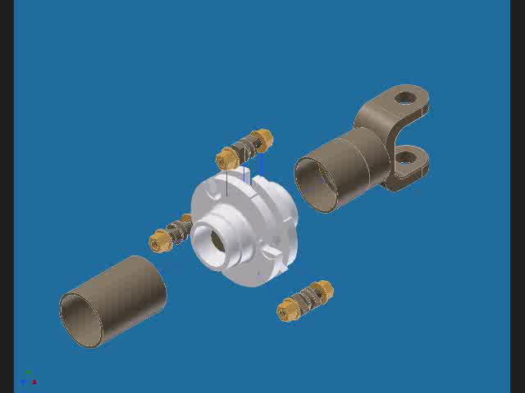
Product Description – Weld in Units
The Power Train Saver is installed into the existing drive shaft and works on a system of shear pins called Torque Fuses
Click on 3D box
to see assembly

Slide 5
Product Description – Weld in Units
When over-torque occurs the Torque Fuses will shear preventing damage to drive shafts, differentials, gears, axles.
After shearing the Power Train Saver unit rotates on an internal support system.

Slide 6
Product Description – Weld in Units
Weld in PTS units are designed with either an internal bushing or an internal sealed bearing.
PTS units with bushings are normally found in manned applications where the unit can be shut down shortly after shearing. (e.g. automotive)
PTS units with bearings are normally found in unmanned applications where immediate shutdown is not always possible. (e.g. industrial)

Slide 7
Installation Notes – Weld in Units
The Power Train Saver must be installed by a qualified driveline mechanic.
( See Welding Procedure & Installation Instructions Page 4,5 and 12 in the parts catalogue )
The PTS is normally installed into the drive shaft ahead of the front differential or just ahead of the steady bearing.
( See Page 4 of parts catalogue )

Slide 8
Installation Notes – Weld in Units
Note: The Power Train Saver must be installed on the weld-in yoke end on all shafts. ( See page 4 installation instructions)

Slide 9
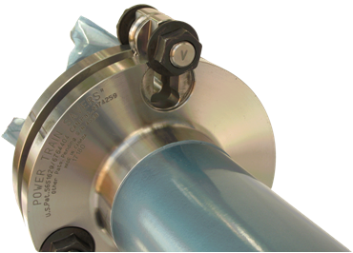
Product Description – Torque Fuses
Once the Power Train Saver is installed the Torque Fuse sizing can be changed up or down without changing the main Power Train Saver.
(See charts on Pages 2 & 3 of Parts Catalogue for recommended fuse sizing)

Slide 10
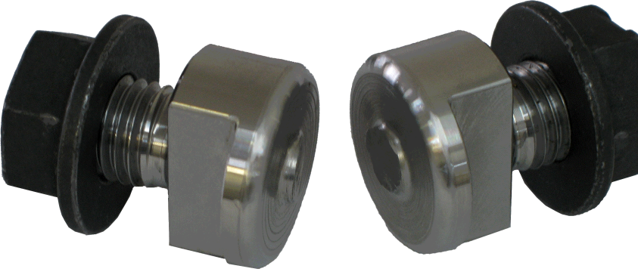
Product Description – Torque Fuses
The Torque Fuses are designed to shear under heavy torque conditions just prior to over torque damage.

Slide 11
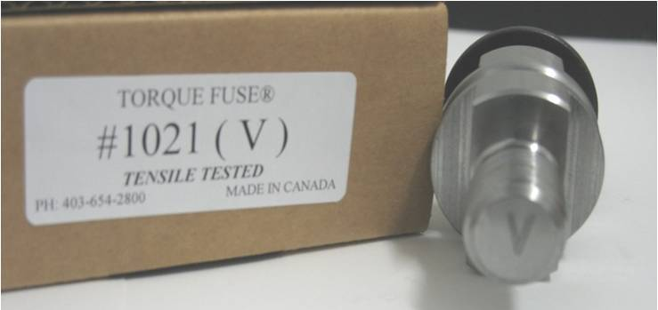
Product Description – Torque Fuses
Torque Fuses are identified with an engraved letter and / or number on one end which corresponds to the rating of the fuse set.
Torque Fuses are engineered, tensile tested and weight rated to be accurate & durable.

Slide 12
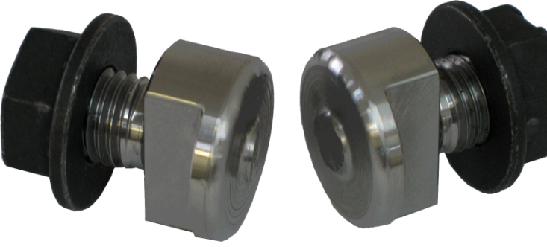
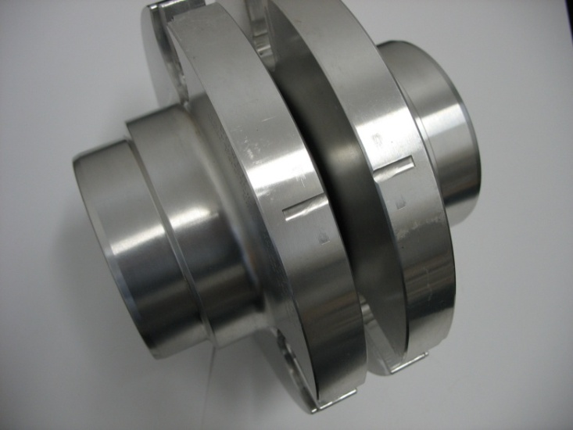
Torque Fuse Replacement Procedure
Back the nuts off the broken Torque Fuse halves and discard them
Ensure the timing marks on both halves of the saver are aligned before installing the new fuses.

Slide 13
Torque Fuse Replacement Procedure
If the timing marks are not clearly visible then line up the yokes for proper alignment.
( See Page 6 – Figure 1 of parts catalogue)
Align End Yokes

Slide 14
Torque Fuse Replacement Procedure
If the timing marks are not aligned all three fuses will not fit into the Power Train Saver unit.
Tighten the back end nuts of the three Torque Fuses as you are installing them.
After all three Torque Fuses are in place then tighten the front end nuts.
Front End
Back End

Slide 15
Torque Fuse Replacement Procedure
Both nuts on all Torque Fuses must be torqued down to at least 220 ft/lbs.
Note: Failure to do so may result in premature torque fuse failure.
Total replacement procedure can be complete within 15 to 25 minutes

Slide 16

Product Description – Industrial Flange Units
The Power Train Saver flange unit bolts up to the companion flange of the drive shaft and the input/output flanges of pumps, transmissions, gear boxes, etc . . .
PTS flange units come in , 11 & 12” sizes – flange face to flange face

Slide 17
Product Description – Industrial Flange Units
After the Torque Fuses shear the Power Train Saver rotates on two double row roller bearings which support the driveline axially.
PTS flange units come in a variety of flange sizes.

Slide 18
Product Description – Marine Units
All PTS Marine units are bolt in style and are 12” flange face to flange face.
The PTS Marine unit bolts up to the output flange of the transmission and the companion flange of the prop shaft.

Slide 19
Product Description – Marine Units
PTS Marine units come equipped with internal thrust bearings making the unit capable of withstanding thrust produced during operation.
PTS Marine units come with a variety of flange sizes to accommodate all makes and models of marine transmissions.

Slide 20
Product Description – Marine Units
Torque fuses for Marine units are sized according to engine and transmission specifications.

Slide 21
Key Selling Points
1. The Power Train Saver will work on all sizes and types of trucks and equipment large and small. The Torque Fuses will Stop Damage not only to drive shafts, but also on gears, differentials, axles. This eliminates down time and costly repairs.
2. The Torque Fuses will only shear just before damage occurs, no matter how big and heavy the truck / equipment.
3. The Power Train Saver unit does not drop down and cause damage after the fuses shear, it rotates freely on an internal support system.

Slide 22

4. Torque Fuses range from 2000 ft/lbs – 45,000 ft/lbs, this works on all sizes of equipment. You can also custom adjust the Torque Fuse ft/lb ratings in just a few minutes without changing the main unit.
5. On pages 2&3 Torque Fuses are already matched to the specific drive train configurations. If differential damage occurs, select fuses at 90% or contact PTS for more specific instructions.
6. Torque Fuses give Peace of mind and over torque protection insurance for the life of the trucks and equipment.

